Slide 1
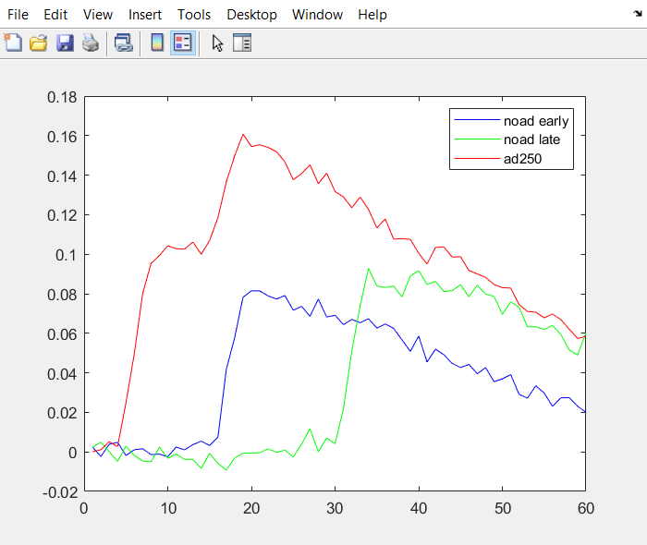
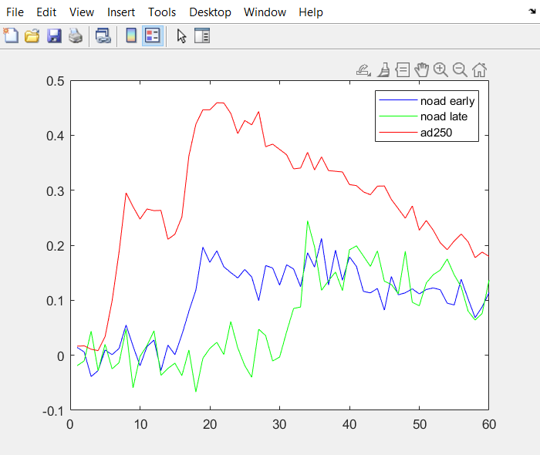
Timecourse of trials when stim2 ori = 90
Vis & ori-mod cells
All cells

Slide 2
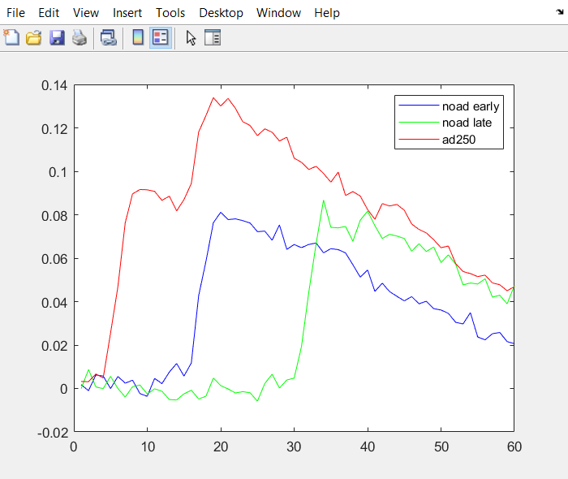
Timecourse of trials when stim2 ori = 90
Vis & ori-mod cells
Vis cells

